Slide 1
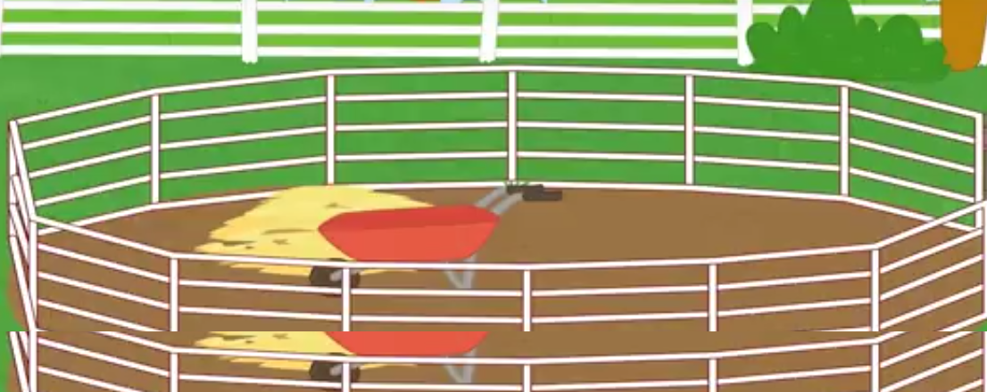
Men in the pen

Slide 2
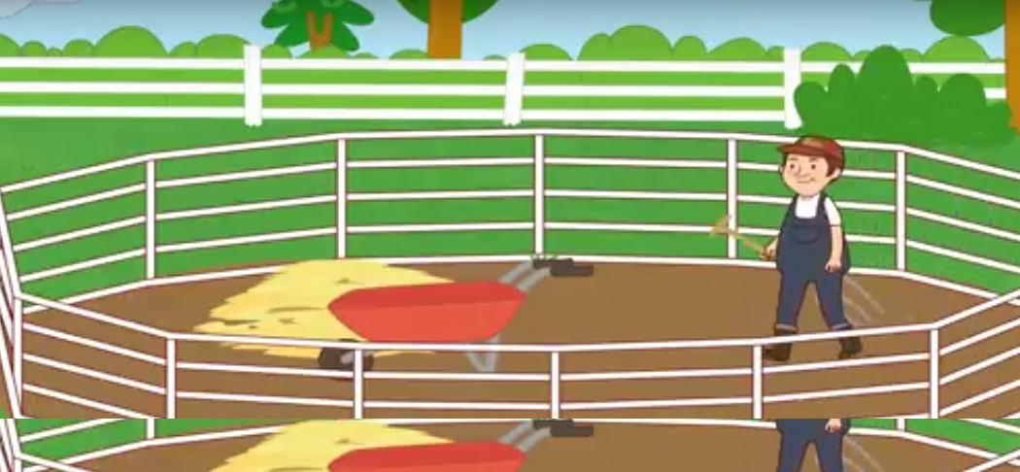
I see a big pen
One man is in the pen

Slide 3
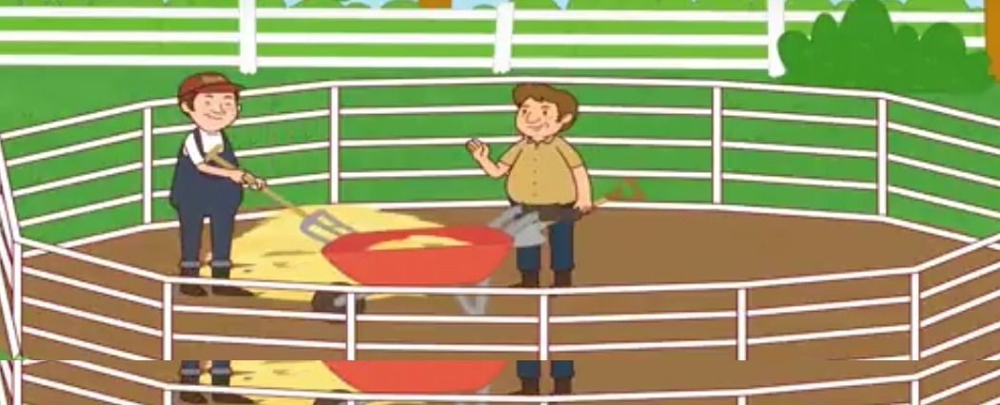
Two men are in the pen

Slide 4
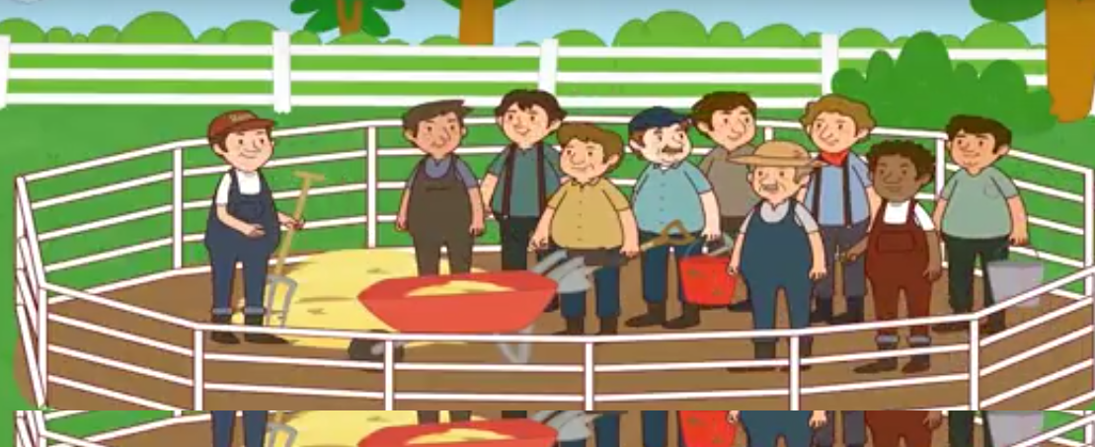
.Ten men are in the pen…

